Slide 1



Noteverse app
Mr. Drupad S (4MN20CS015)
Mr. Syed Zeeshan (4MN20CS050)
Under the guidance of:
Prof. Arpitha K,
Assistant Professor,
Dept. of Computer Science & Engineering,
Maharaja Institute of Technology Thandavapura
Mobile Application Development – 18CSMP68

Slide 2
CONTENTS
Introduction
Existing System
Proposed System
Software Requirements
Hardware Requirements
Mobile Application Development – 18CSMP68

Slide 3

INTRODUCTION
Open Source Notes is an innovative note-taking application that embraces the principles of open-source software development. It is designed to provide users with a flexible, customizable, and collaborative platform for capturing and organizing their thoughts, ideas, and information.
This application expands on the generic note taking features of other basic applications and allows for users to attach image and video files, use a variety of widgets, tag and organize notes, search through notes, and customize the applications UI.
Mobile Application Development – 18CSMP68

Slide 4

EXISTING SYSTEM
Lack of organization
Limited collaboration features
Absence of cross-platform synchronization
Inflexible user interfaces
Limited multimedia support
Lack of advanced formatting options
Mobile Application Development – 18CSMP68

Slide 5
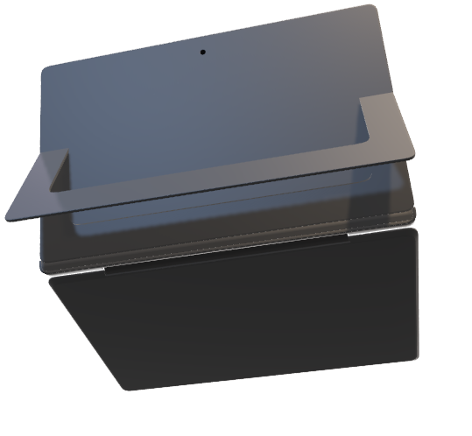
PROPOSED SYSTEM
Enhanced Collaboration
Rich Media Support
Improved Organization
Seamless Sharing
Cross-Platform Syncing
Data Backup and Security
Mobile Application Development – 18CSMP68

Slide 6

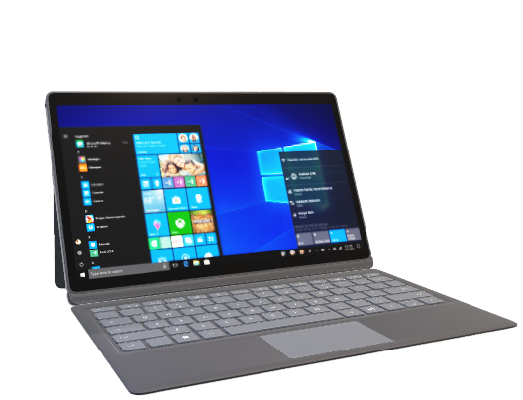
SOFTTWARE REQUIREMENTS
Integrated Development Environment (IDE)
Java Development Kit (JDK)
Android Software Development Kit (SDK)
Emulator or Physical Device
Version Control System
Database
Mobile Application Development – 18CSMP68

Slide 7

HARDWARE REQUIREMENTS
RAM – 8GB
Storage – 10 GB free space
Processor – intel core i5 or more
Global positioning system
Internet Connectivity
Android Device for Testing (optional)
Mobile Application Development – 18CSMP68

Slide 8
METHODOLOGY
Modules in this system:
User module

Slide 9
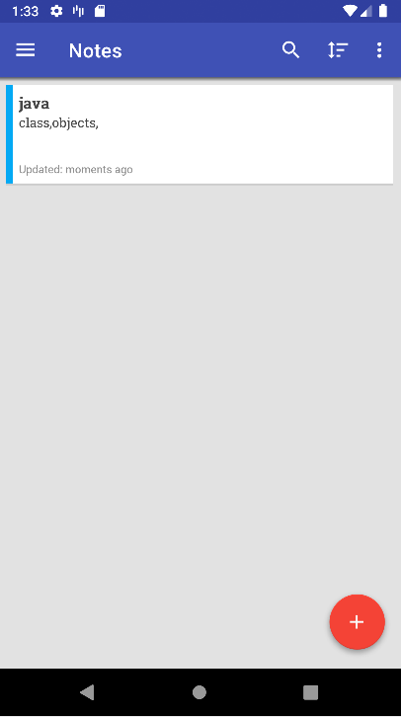
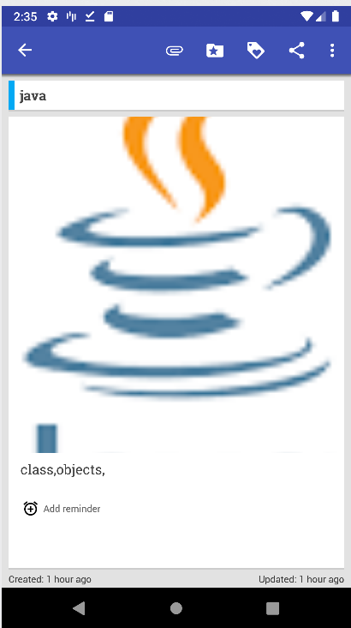
USER INTERFACE

Slide 10
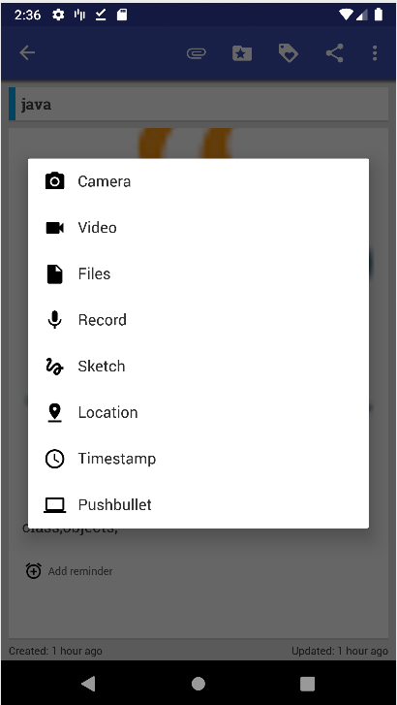
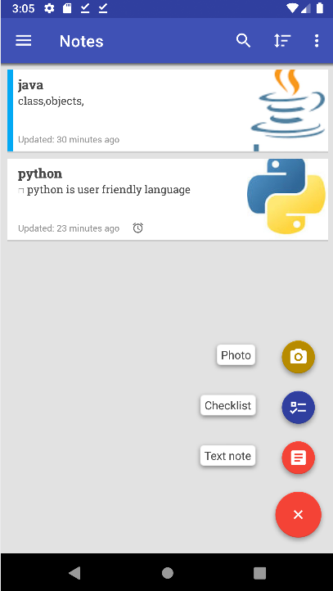
MULTIMEDIA SUPPORT

Slide 11
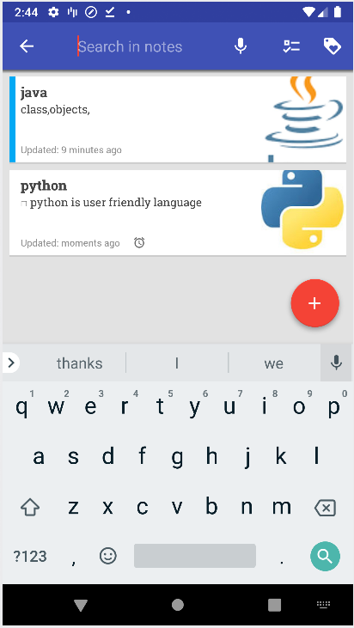
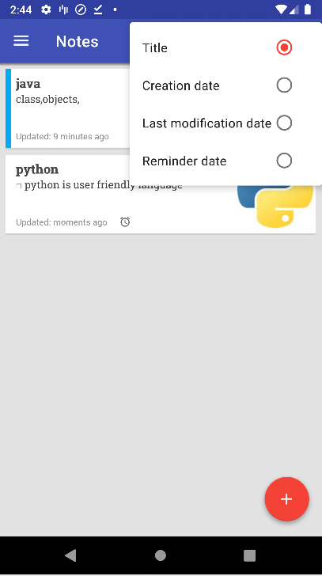
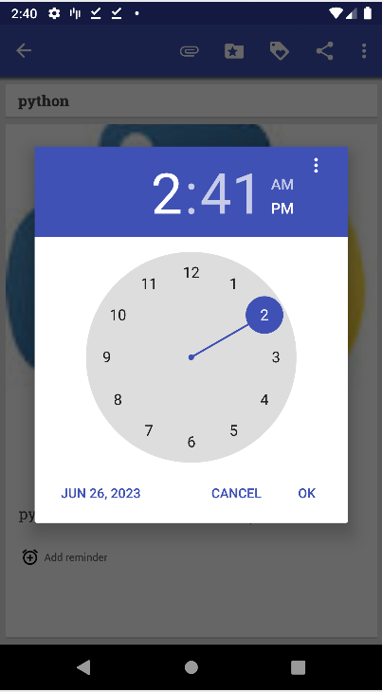
ORGANISING AND SCHEDULING DATA

Slide 12
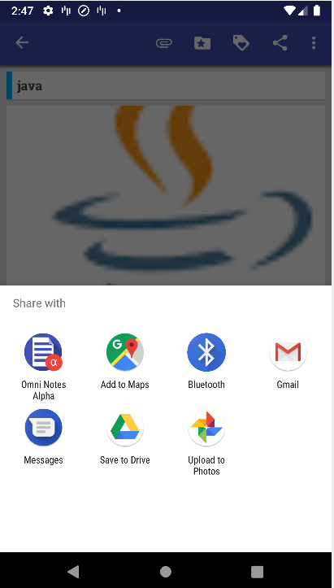
SHARING AND COLLABORATION

Slide 13
FUTURE UPGRADATION AND ENHANCEMENT
Integrating web-based interface
Integration with external apps
Intelligent organizing feature

Slide 14

Any suggestions!
Mobile Application Development – 18CSMP68

Slide 15

Thank You Listeners!
Mobile Application Development – 18CSMP68

